Slide 1
Visitor Management System
: Design & Developed By :
Ram Prakash
Echo Software Consultancy Services
Mobile : +91 9821885190
Email : echonetin@yahoo.in
https://www.echonet.in/HousingsocietyOnLine.aspx

Slide 2
Visitor Management System
Can be operated using Android App / Website
Security personnel can click photo and enter details of visitor.
Society Admin can get details of visitor in .pdf format , to keep printout / soft copy of visitors.
Visitor also can scan the QR code , kept with security , to enter own details.
With entry SMS will be sent to society member or Tenant (if tenant staying) and Visitor.
Society member can allow / disallow / send specific instruction to security personnel for visitor using website / App.
For repeated visitor , photo need not to click. with mobile number of visitor , photo and details filled up on App screen.
Visitor data can be deleted / edited by Society Admin only.
Password can be assigned to all Society Members , Gate Security , Pool / Club house security , Employee. (Password for Android App and Website)

Slide 3
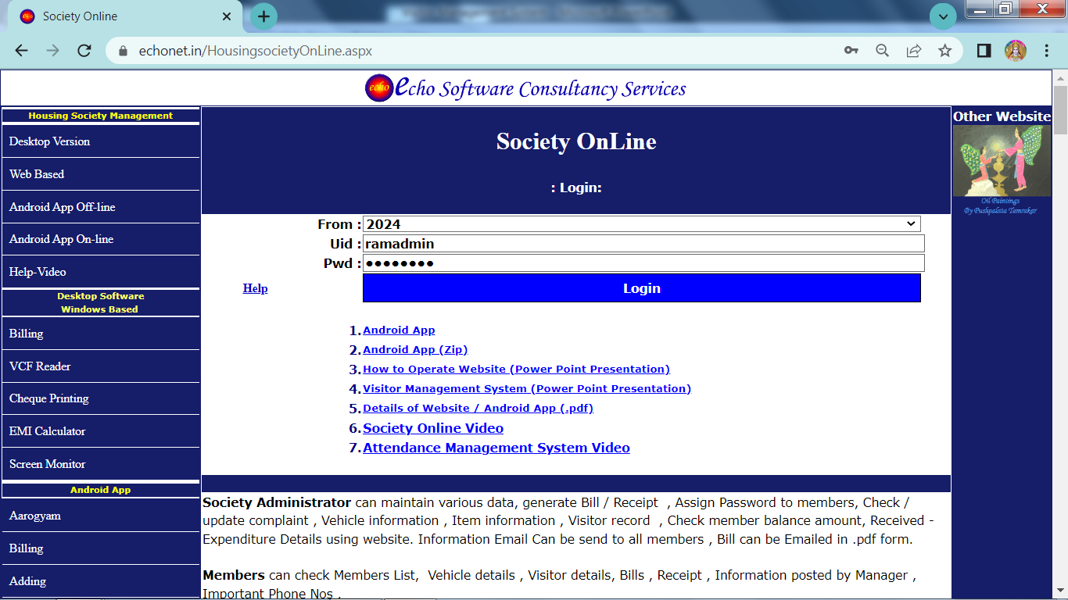
Website to Enter Member & Property Data
https://www.echonet.in/HousingsocietyOnLine.aspx

Slide 4
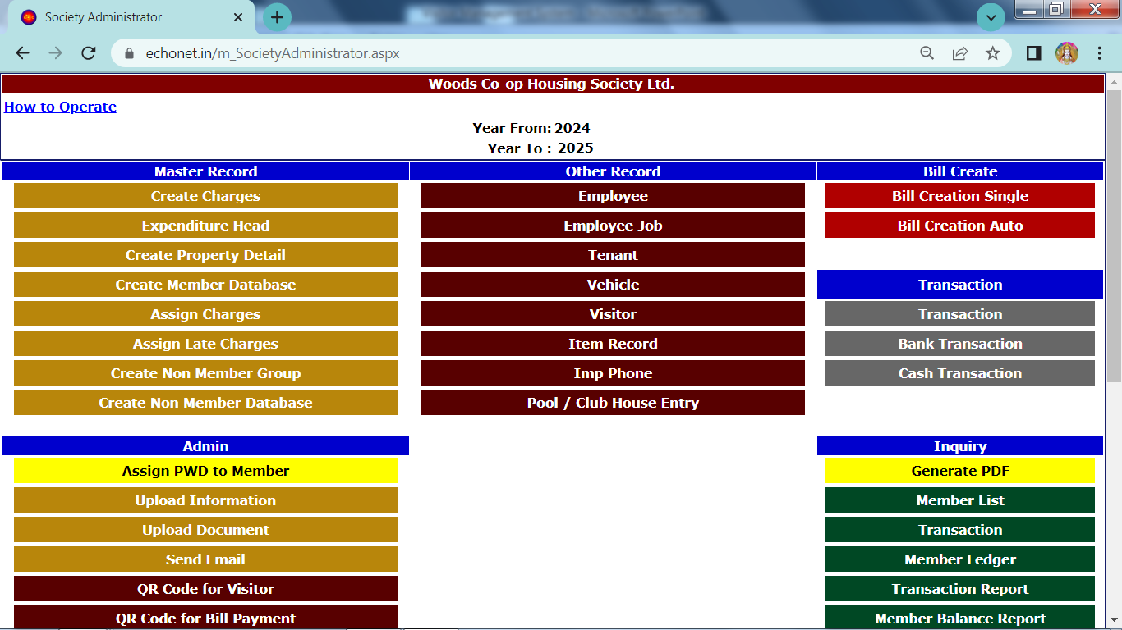
Website to Enter Member & Property Data
Create Property Detail
Create Member Database
QR Code for Visitor
Visitor details
Assign Password
Get details in .pdf format.

Slide 5
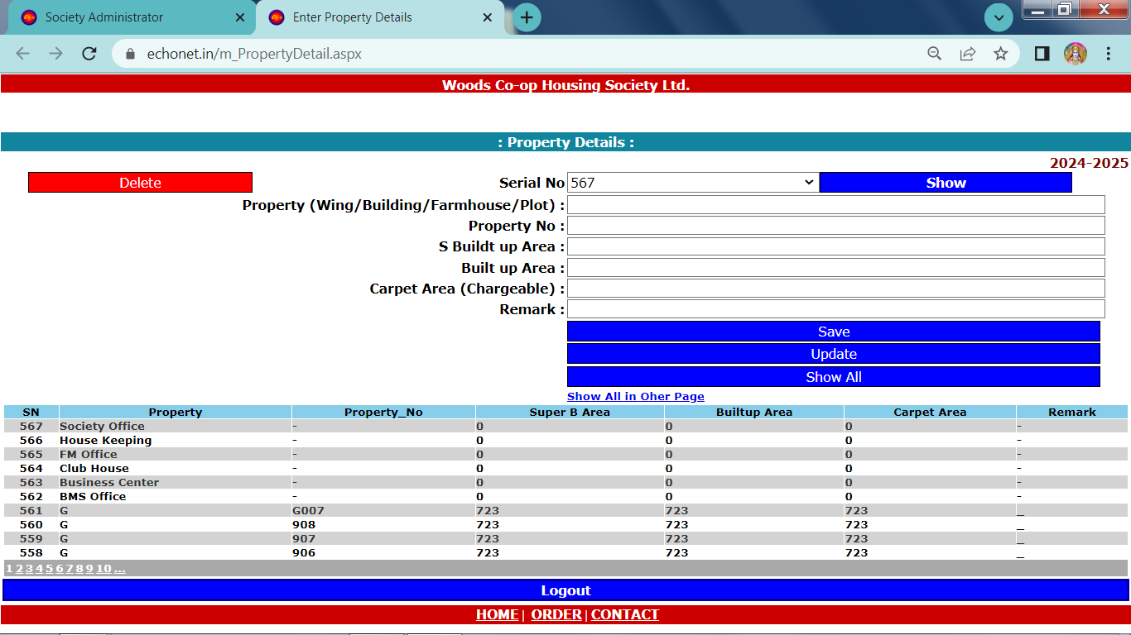
Website to Enter Property Data https://www.echonet.in/HousingsocietyOnLine.aspx

Slide 6
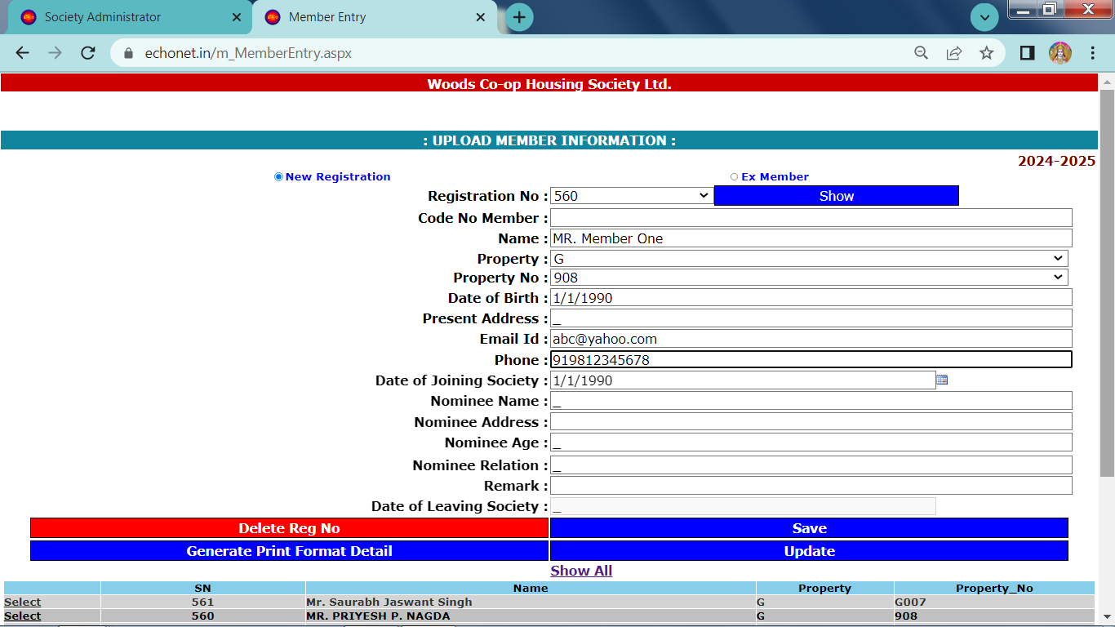
Website to Enter Member Data https://www.echonet.in/HousingsocietyOnLine.aspx

Slide 7
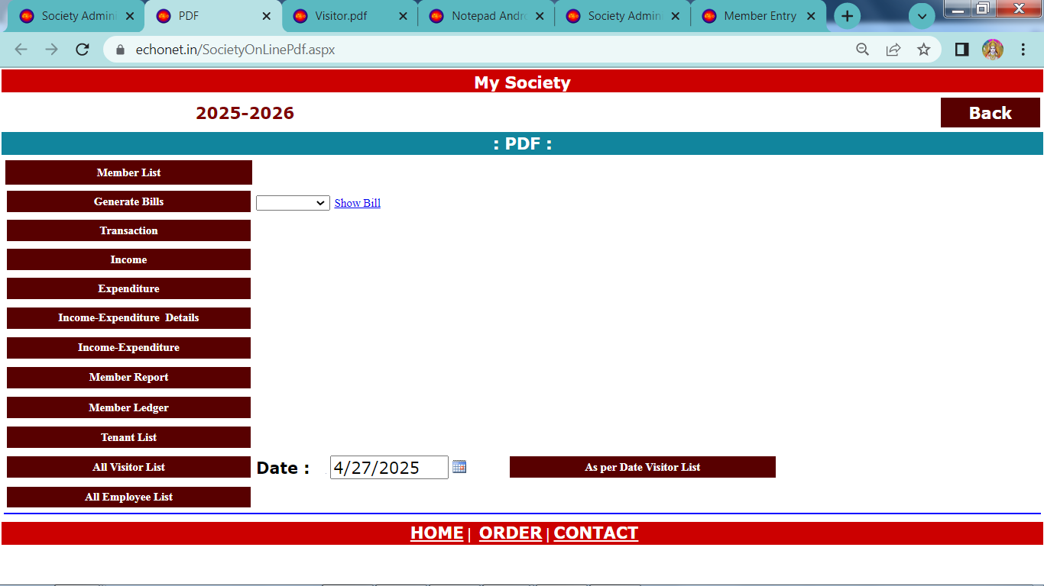
Visitor details in .pdf format
Click to generate Visitor list in .pdf format
Admin -> Generate PDF

Slide 8
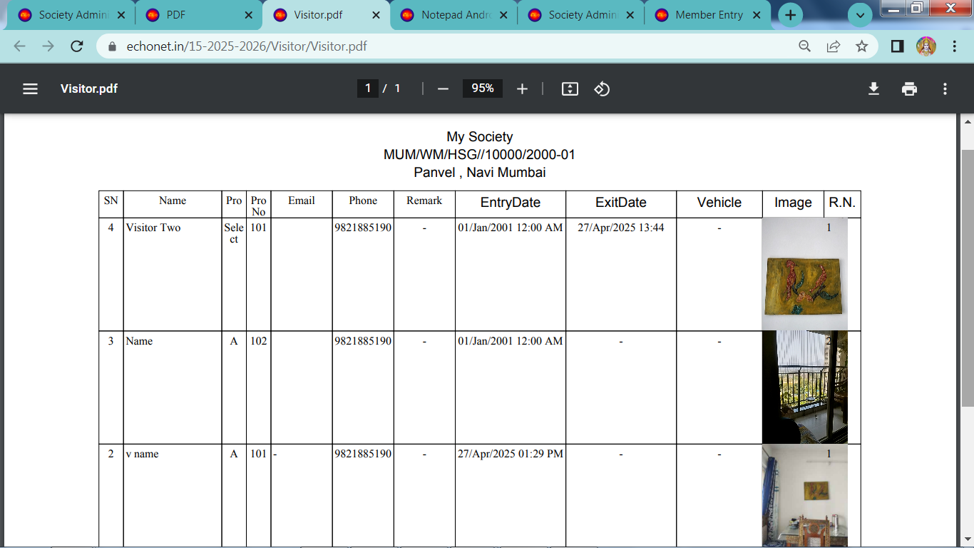
Visitor details in .pdf format
Admin -> Generate PDF ( All visitor list OR As per date Visitor List

Slide 9
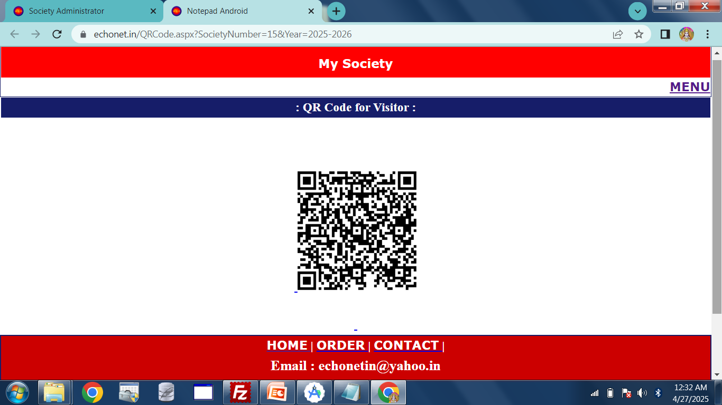
How Visitor scan QR Code to Enter own data
This QR code in print form ,can be placed
Near security Gate.
Visitor can scan QR code and
fill own details using website.
Security can check , whether
visitor entered correct own data
or not using Android App.
Admin - > QR Code for visitor

Slide 10
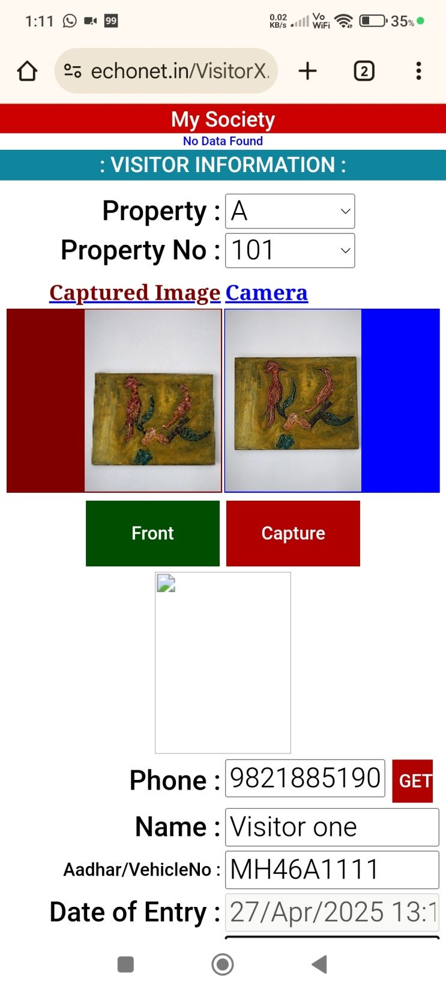
After QR Code scanning ,
Visitor click Open in browser
button , in scanner App of
Own mobile.
Then ->
webpage will be Open.
Visitor can fill all data and
Use Front / Back camera to
Capture own photo.
At last click Entry Button.
During Exit , Visitor write Mobile number , click Get Button, so that all details will be filled up.
Then click Exit Button.

Slide 11
Android App
After Property , Member Database Entry and Password assignment to all Members / Security Personnel , Android App ready for use.
: Android App can be Downloaded from :
https://www.echonet.in/HousingsocietyOnLine.aspx
1. Android App

Slide 12
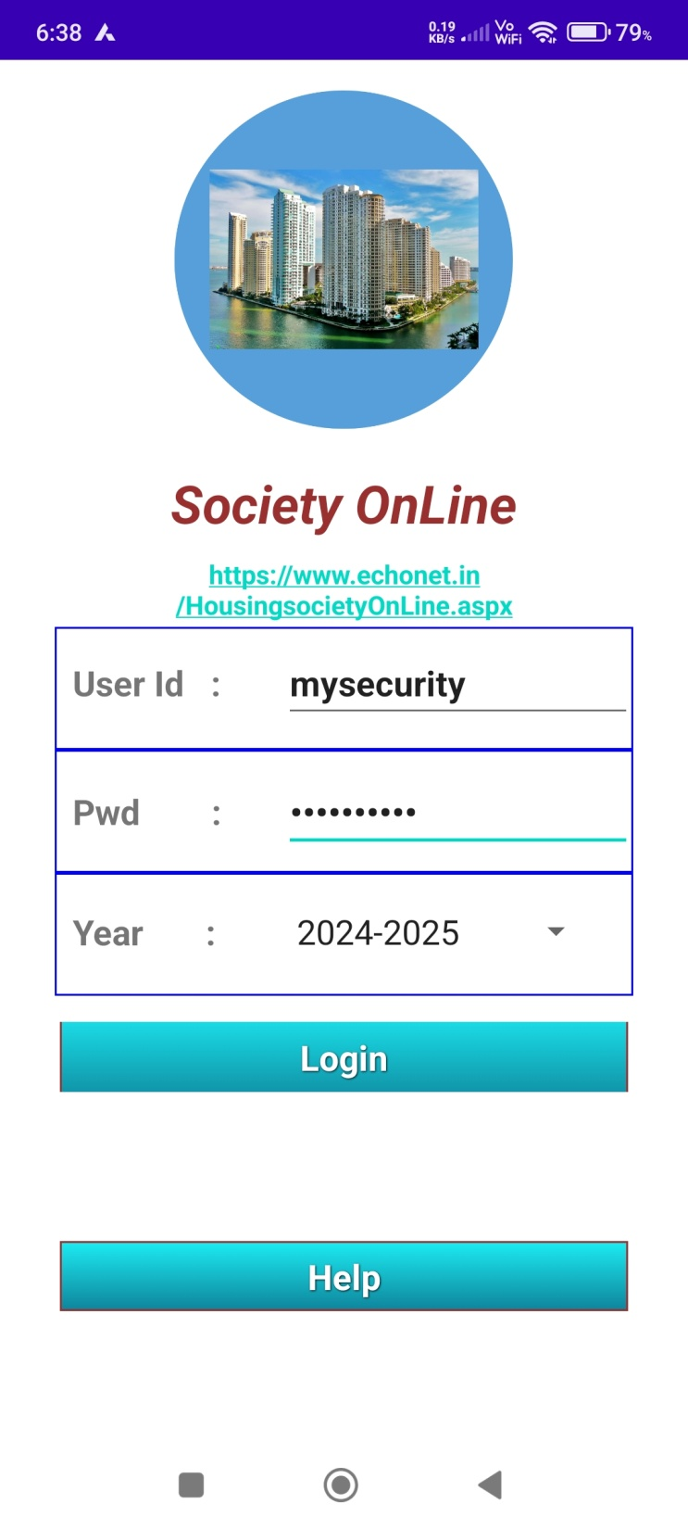
Android App Login

Slide 13
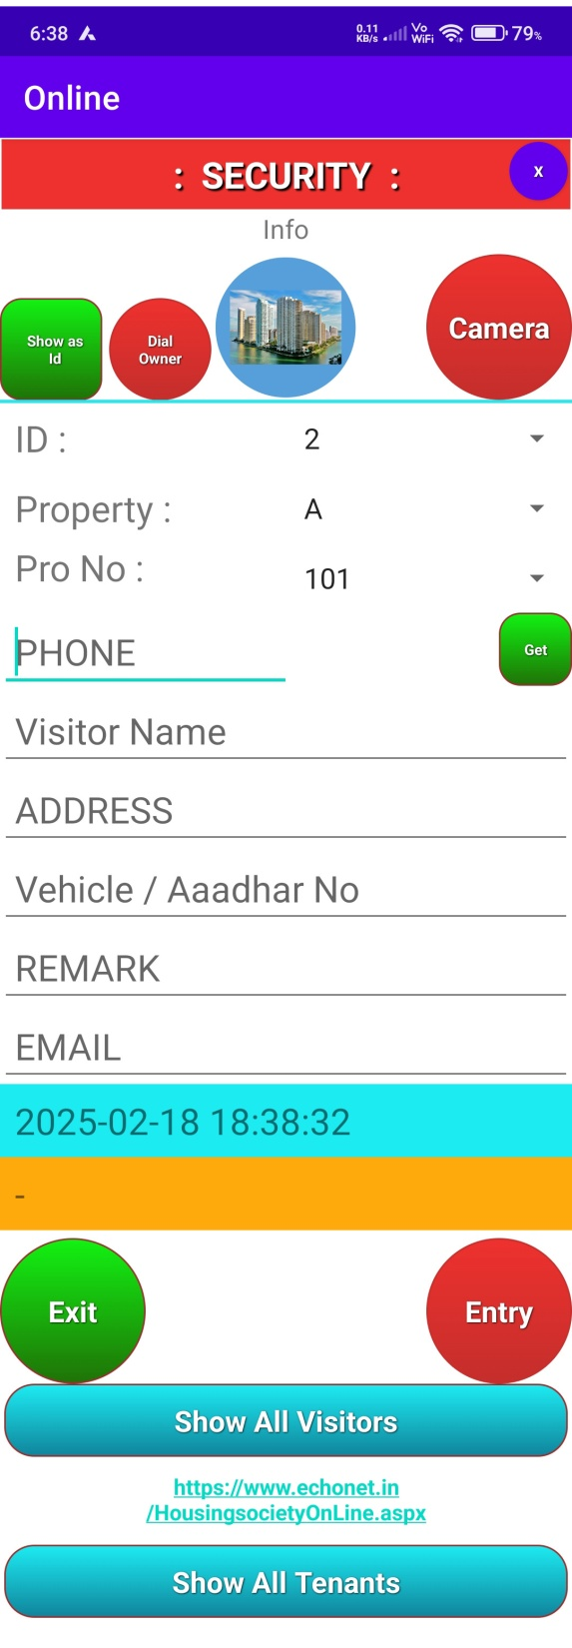
Click to Dial Owner.
Prior to Click
select Property and
Pro No
Click to get
Photo of Visitor
Click to fill Visitor Data
as per ID
Write Mobile number of
Visitor
Click this Button.
If Visitor already visited earlier then old data of visitor will be filled.
Need not to take again photo. Only Property and Pro nu to be entered.
Select ID and Click Exit Button to add Exit time
Click to get all
Visitor list
After all data ,
Click this Button
For Visitor Entry

Slide 14
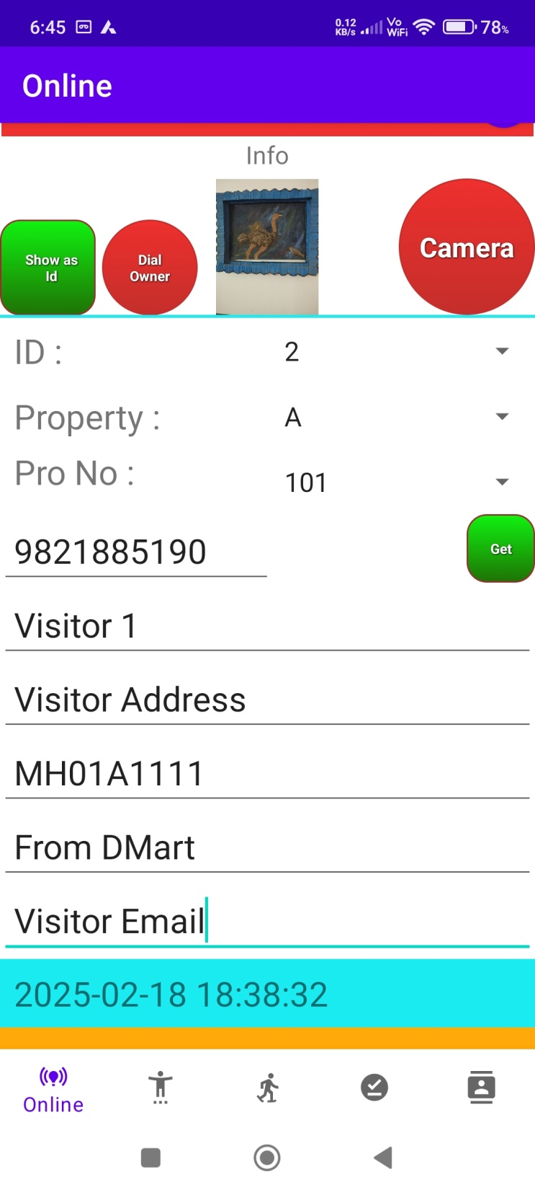
Entry Sample

Slide 15
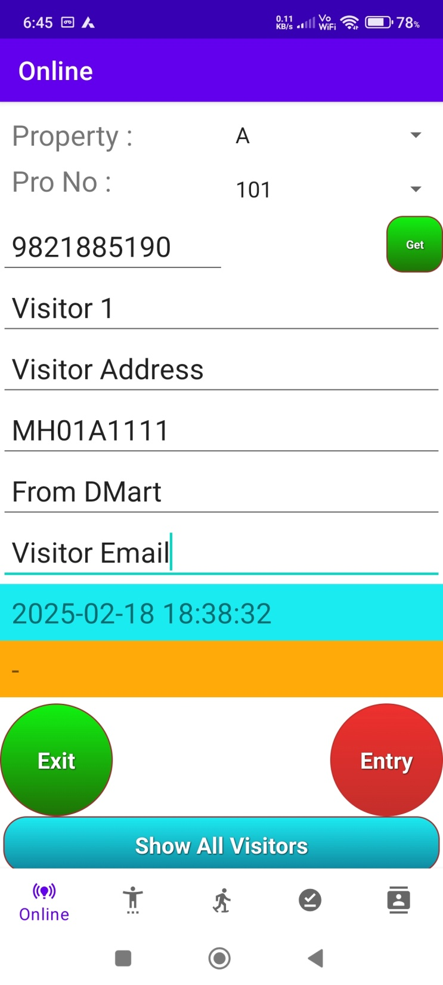
Online Visitor Entry
Offline Visitor Entry
IN Visitor List
Out Visitor List

Slide 16
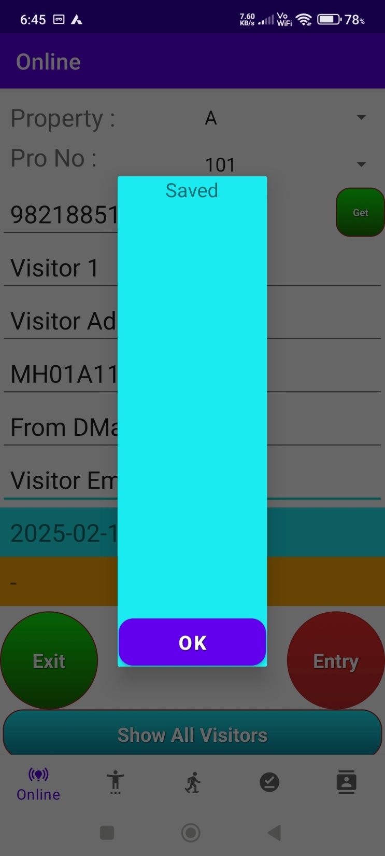
After Entry
Saved Information

Slide 17
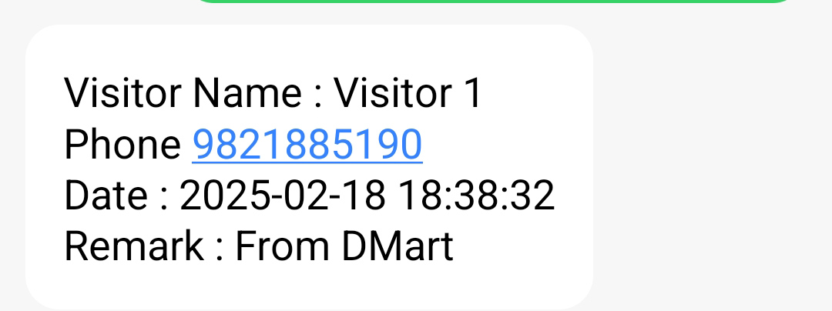
With Entry SMS to owner

Slide 18
With Entry SMS to Visitor

Slide 19
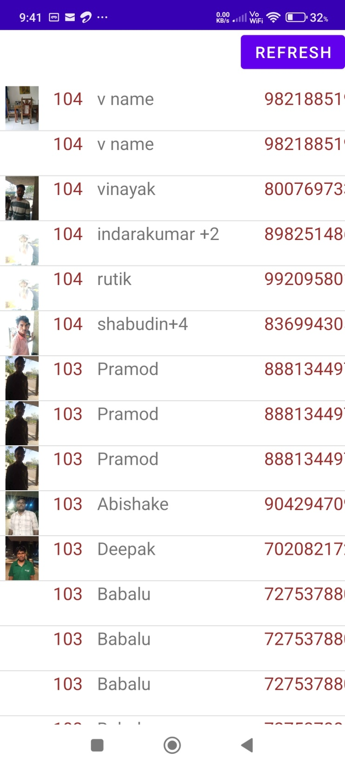
Visitor List
Visitor List

Slide 20
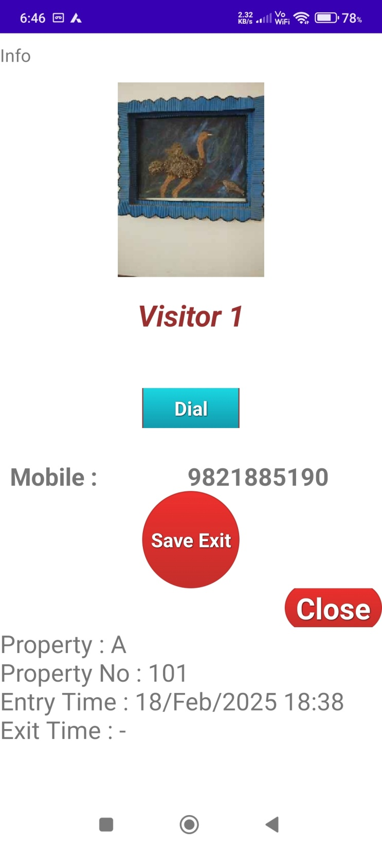
Visitor Details when
click Photo of Visitor at
Visitor List.
Visitor can be contacted
With Dial button.
Click Save Exit during to
Save Exit time of Visitor.
Close : to close this page and
return to Visitor List.

Slide 21
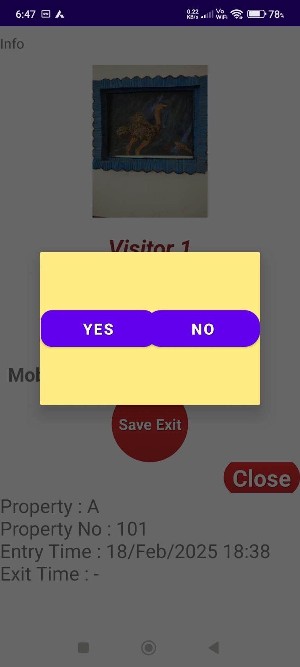
After click Save Exit Button.

Slide 22
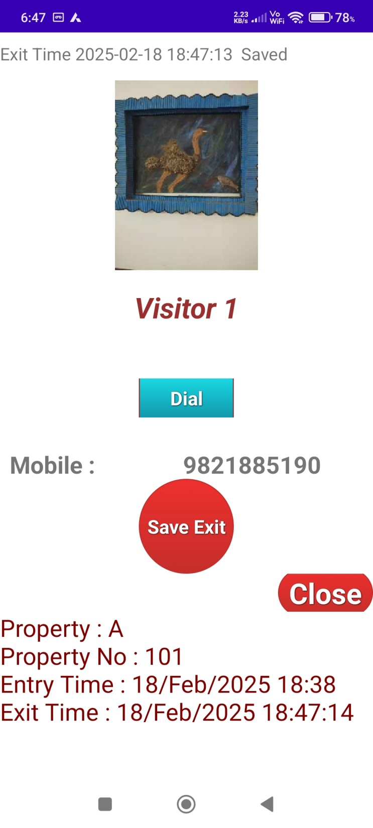
After click Save Exit Time entered

Slide 23
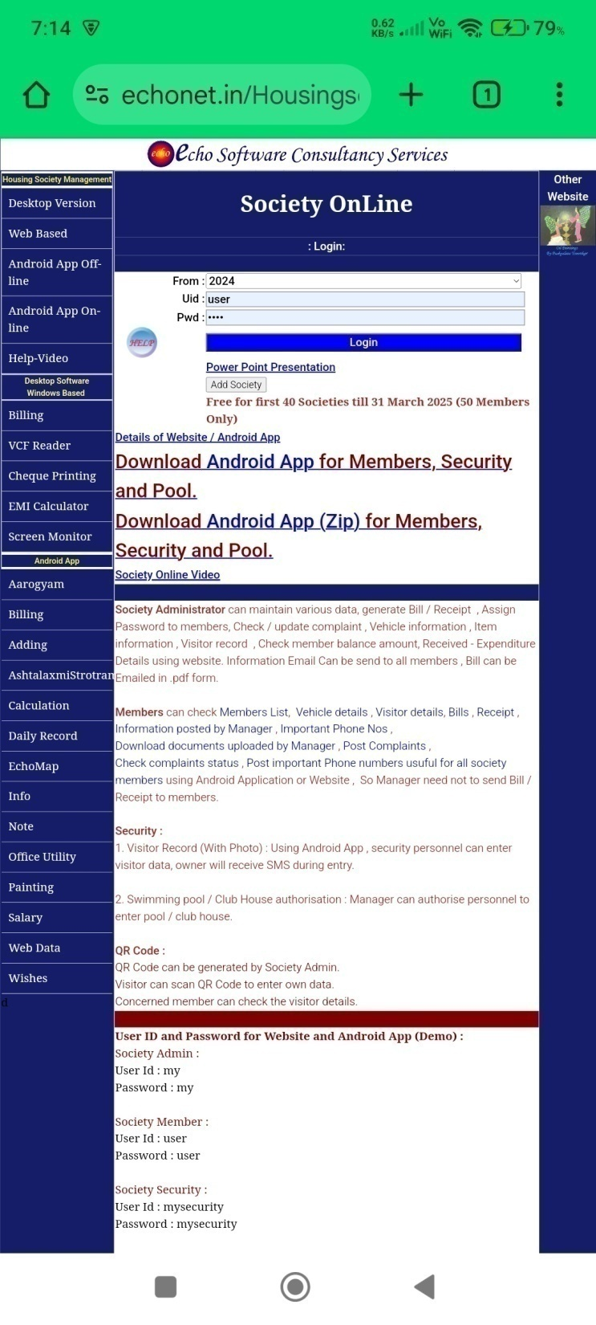
Website Login by Members
to send Instruction
to Security

Slide 24
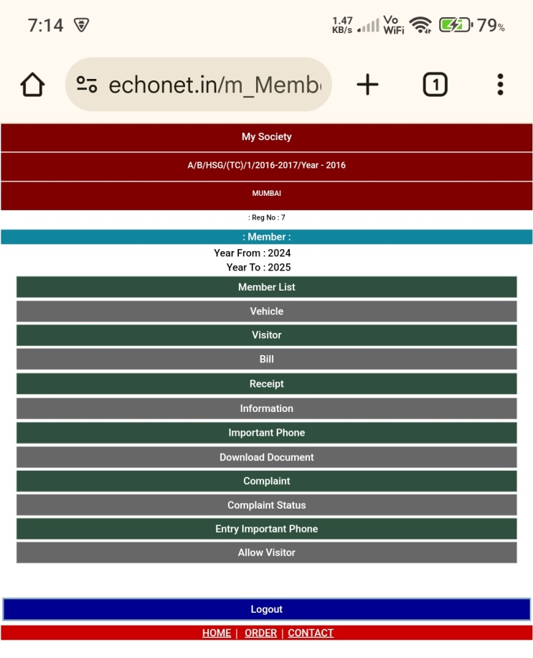
Click to
add Instruction
for Visitor

Slide 25
Save Instruction for Security

Slide 26
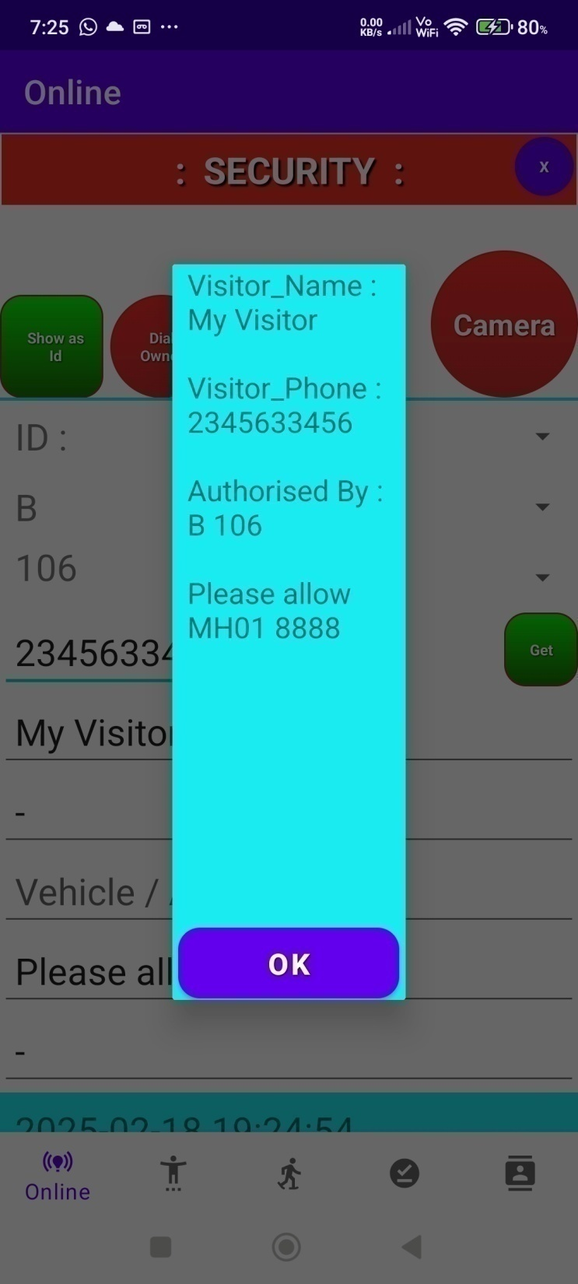
On Android App :
Message will display ,
when security will click
Get Button
after entering
Mobile number of
Visitor.

Slide 27
Save Instruction for Security

Slide 28
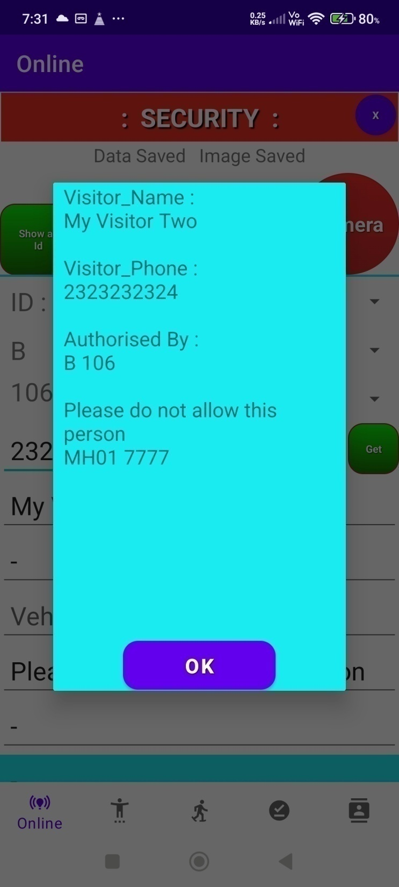
Message will display ,
when security will click
Get Button
after entering
Mobile number of
Visitor.

Slide 29
Thanks….
For Watching
Visitor Management System
: Designed and developed by :
Ram Prakash
Mob : 9821885190
Website : https://www.echonet.in
: Please contact :
For any website and Android App development

Slide 30
Thanks….
For Watching
Visitor Management System
: Designed and developed by :
Ram Prakash
Mob : 9821885190
Website : https://www.echonet.in
: Please contact :
For any website and Android App development

